Slide 1
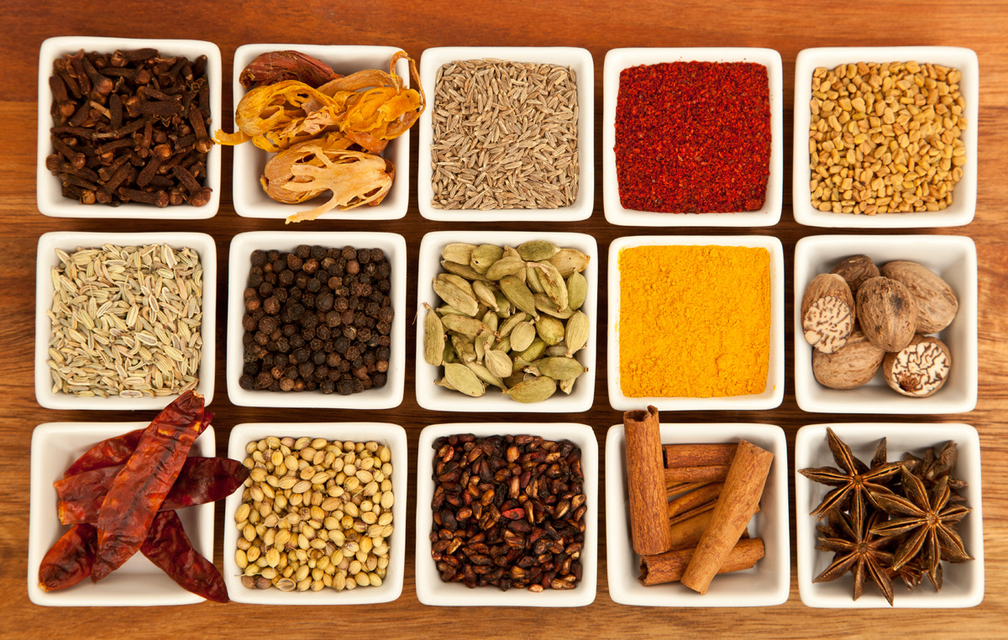
Where to open an Indian restaurant in Ireland?
Capstone Project for the IBM Data Science course
Tamela Maciel, June 2020
Image credit: Joe mon bkk, Wikimedia Commons

Slide 2
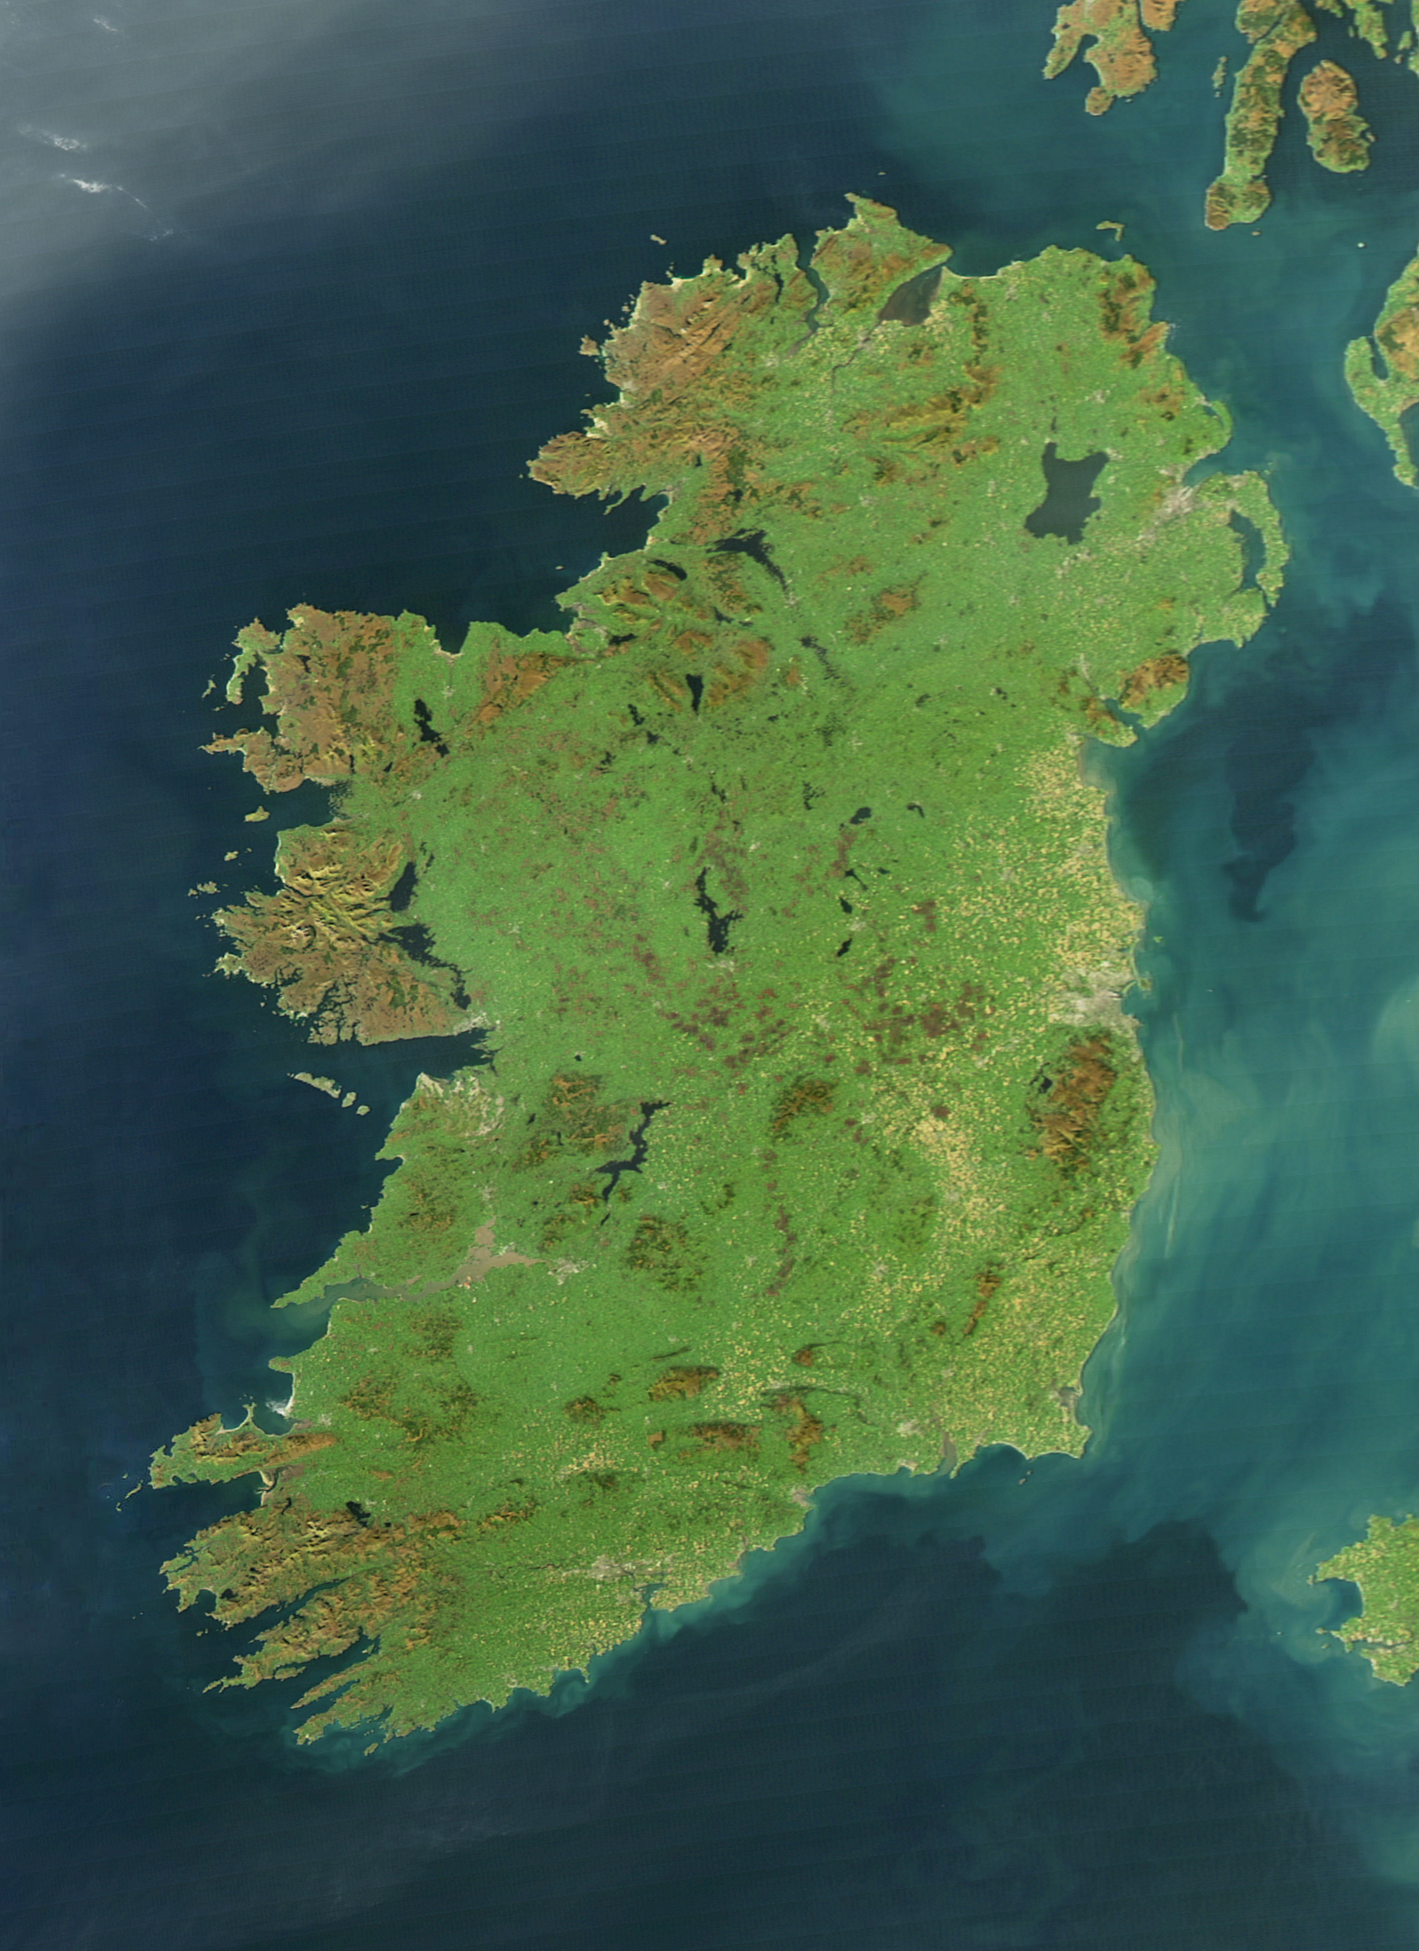
Where to open an Indian restaurant in Ireland?
Our client runs several successful Indian restaurants in Leicester.
Now seeking opportunities to expand into Ireland.
Three criteria for a successful new Indian restaurant:
A city in Ireland that is similar or larger in relative size compared to Leicester.
A relative lack of Indian restaurants in that city.
A relatively high proportion of residents who are Asian (non-Chinese)

Slide 3
Data – Acquisition and Cleaning
Data source:
UK and Irish urban populations from 2011 UK census and 2016 Irish census, scraped from two Wikipedia tables (UK, Ireland) -> 13 Irish cities of similar or larger relative size to Leicester.
City centre locations from Nominatim (via python geopy.geocoders)
Ethnicity of Irish residents, by administrative county, from Central Statistics Office website , along with geographic county boundaries from data.gov.ie -> cities ranked by the proportion of Asian (non-Chinese) residents in their county.
Restaurant frequency, location, and type, per city, from the Foursquare API -> top restaurants per city (range from 3 to 47 restaurants)
Final dataset:
13 most populous Irish cities, with 17 key features ranging from population, demographics, and restaurants

Slide 4
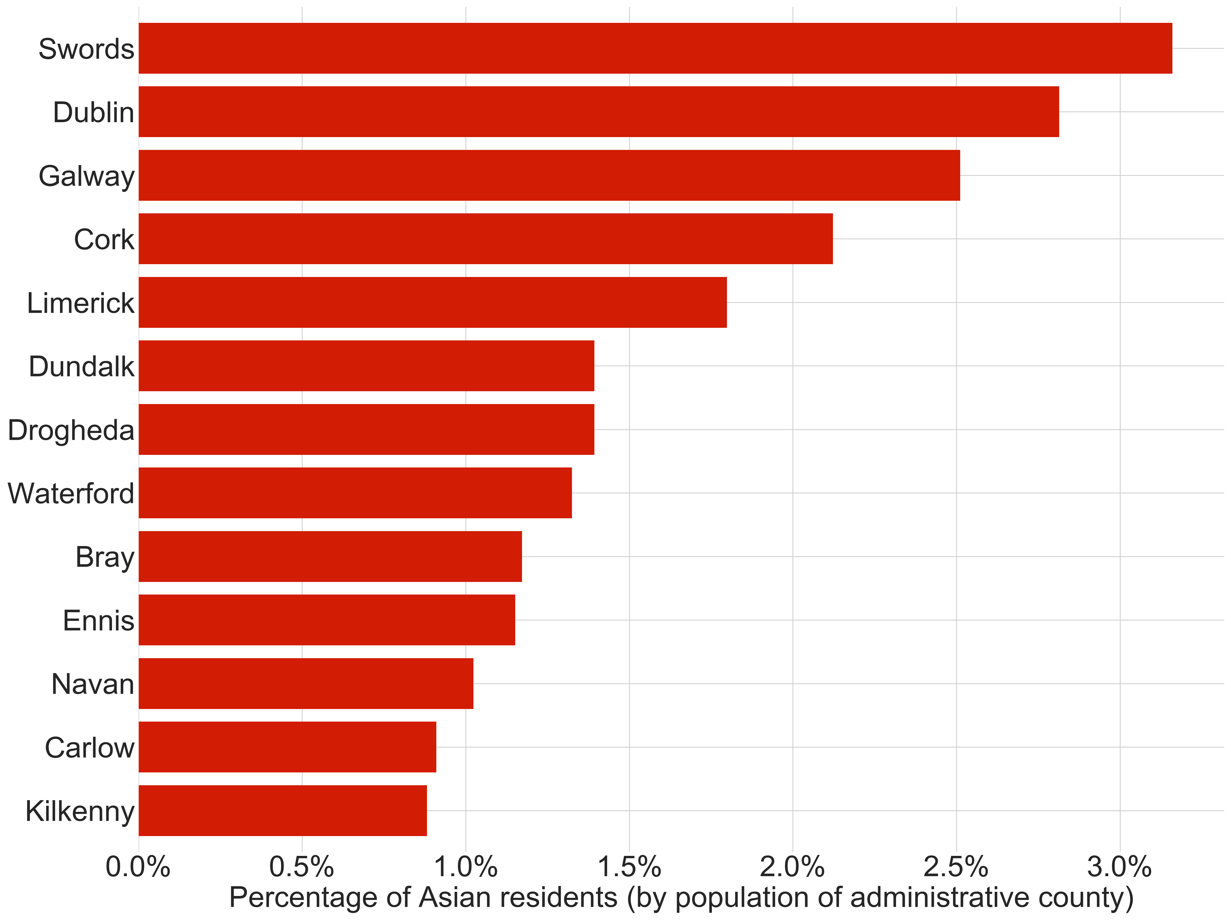
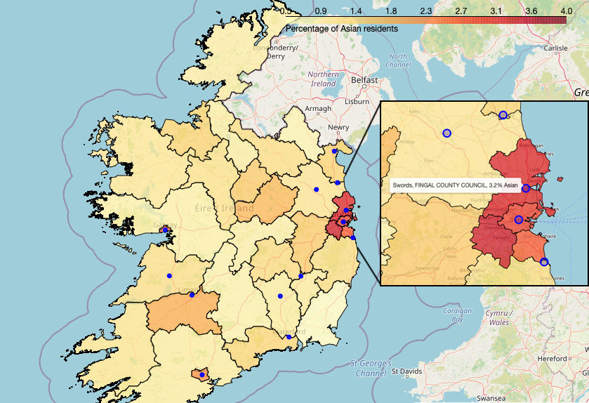
Exploratory Analysis
The 13 most populous cities ranked by the percentage of Asian (non-Chinese) residents per administrative county.

Slide 5
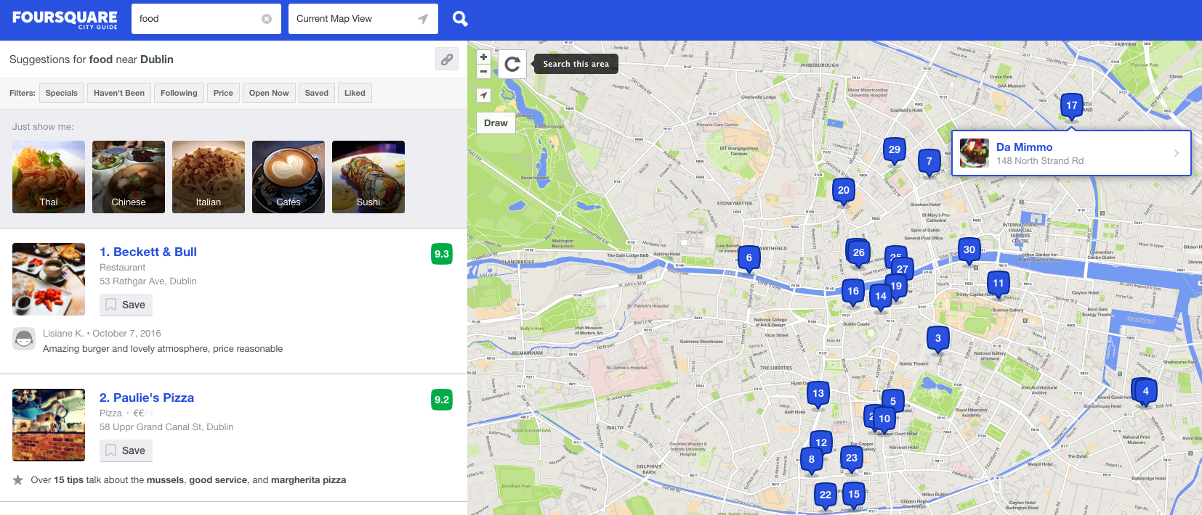
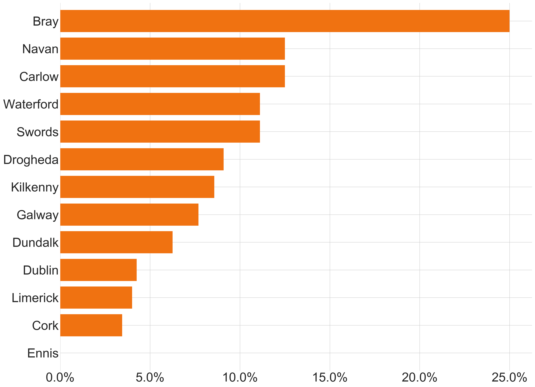
Exploratory Analysis
252 restaurants across 13 Irish cities
7.1% are Indian restaurants
Barchart: 13 cities, ranked by the percentage of Indian restaurants within 1.5 kilometres of their city centres.

Slide 6
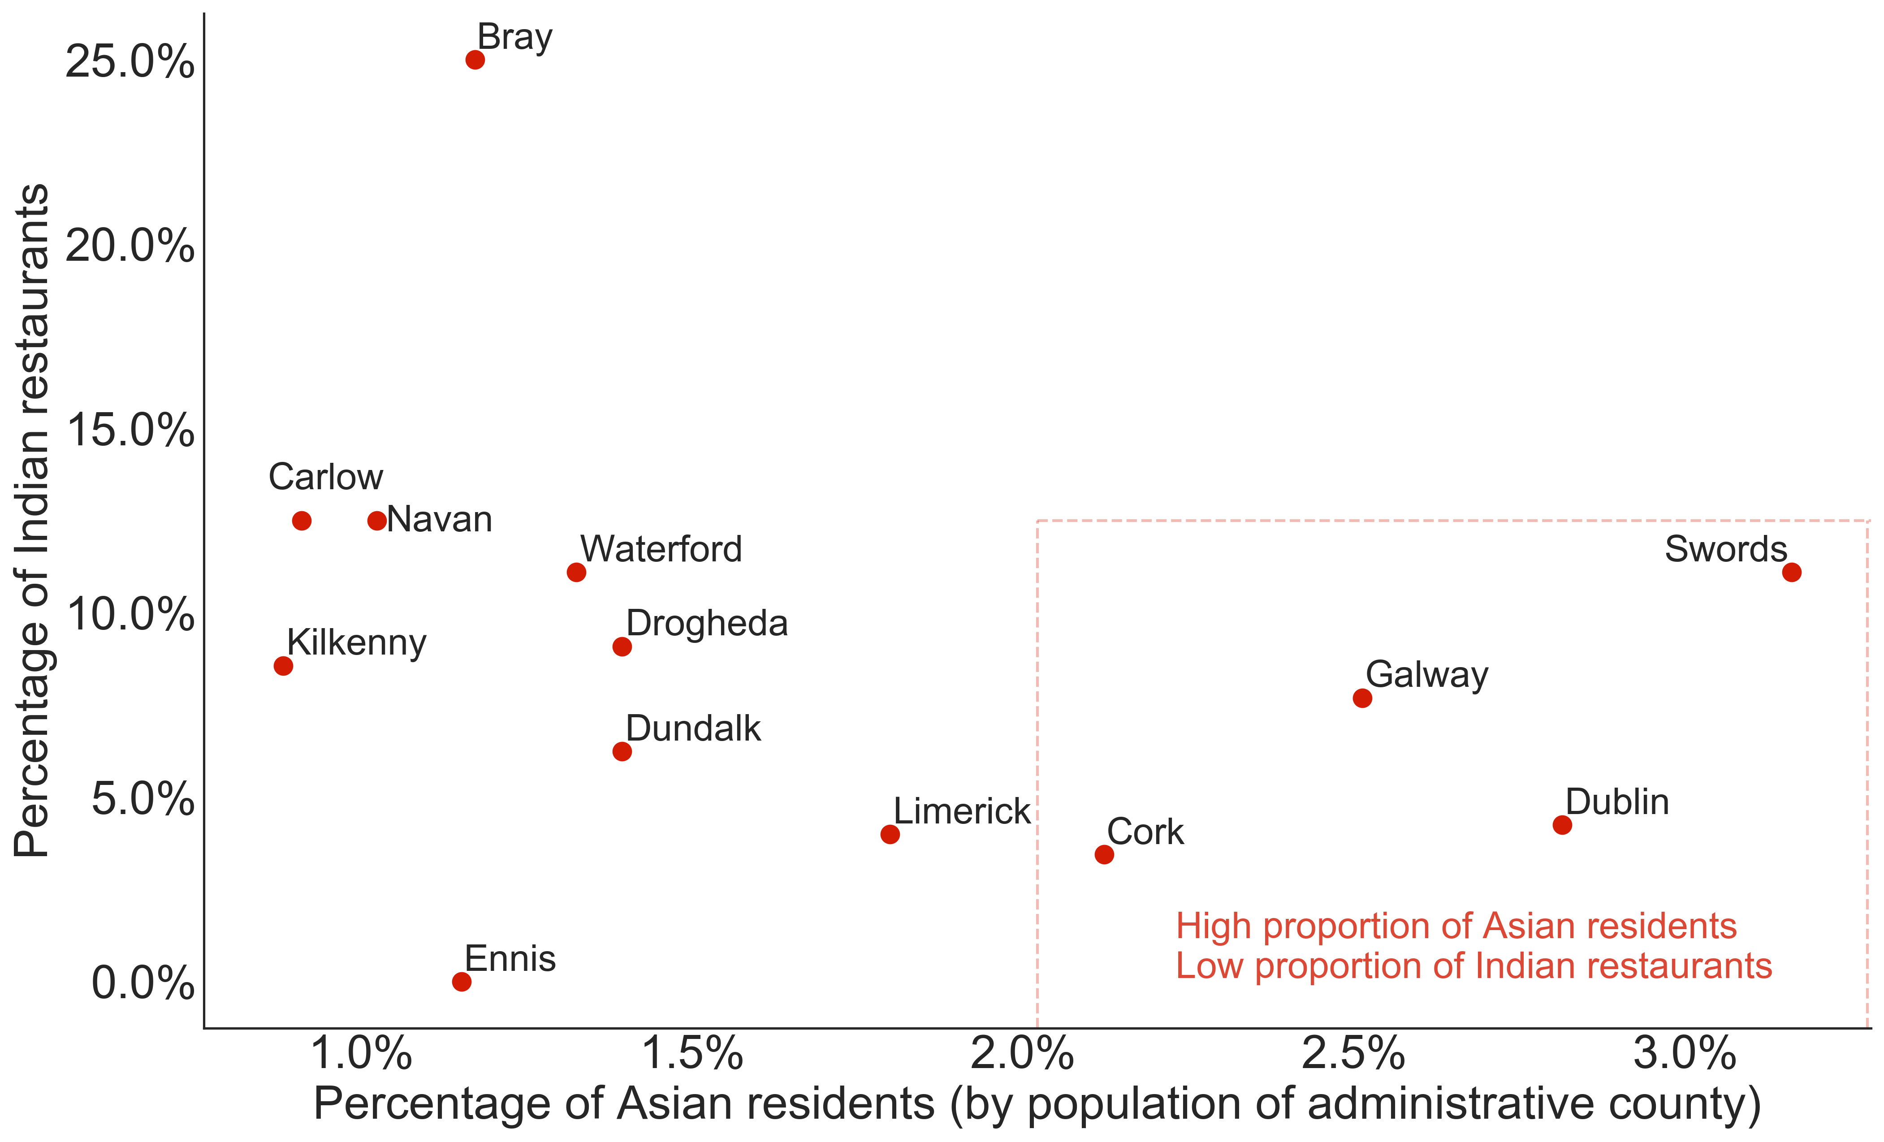
Exploratory Analysis
The 13 most populous cities, ranked by their percentage of Asian residents and Indian restaurants.
Shortlist of cities that meets the client’s three criteria:
Swords
Dublin
Galway
Cork

Slide 7
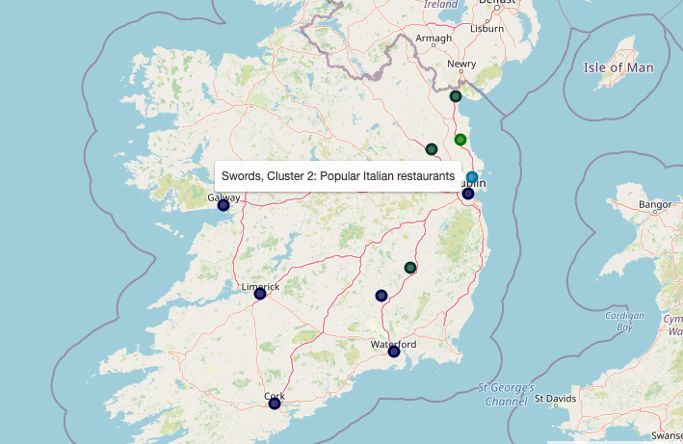
City Clustering by Restaurants
K-means clustering of the frequency of 30 unique types of restaurants, per city
Dropped 2 cities with <5 restaurants
4 clusters for in the least error per cluster
Cluster | No. of cities | Cities | Profile description
1 | 3 | Carlow, Navan, Dundalk | Mid-size cities, popular Chinese-Asian restaurants
2 | 6 | Dublin, Cork, Galway, Limerick, Waterford, Kilkenny | Larger cities, popular generic ‘restaurants’
3 | 1 | Swords | Swords, popular Italian restaurants
4 | 1 | Drogheda | Drogheda, popular generic and Mediterranean restaurants

Slide 8
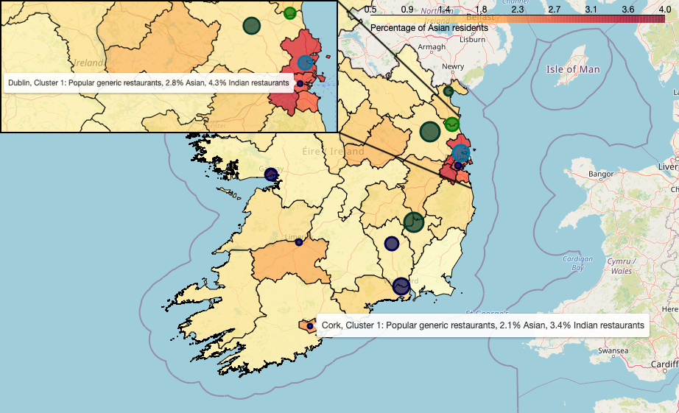
Recommendations
Best cities to in which to open a new Indian restaurant
Based on cluster profiles, and demographics for each city and county
Top three recommendations:
Dublin: 2.8% Asian population, only 2 Indian restaurants out of 47 (4.3%)
Swords: 3.2% Asian population, only 1 Indian restaurant out of 9 (11.1%)
Cork: 2.1% Asian population, only 1 Indian restaurant out of 29 (3.4%)
Two runners-up:
Galway: 2.5% Asian population, only 3 Indian restaurants out of 39 (7.7%). But 3rd most common restaurant is an Indian
Limerick: 1.8% Asian population, only 1 Indian restaurant out of 25 (4%)
Choropleth of the percentage of Asian per administrative county. The final 11 cities are coloured by restaurant cluster. The circle size indicates the percentage of Indian restaurants.

Slide 9
Future investigations
This study limited to demographics and restaurant data on a city-level basis.
Our recommendations are a starting point for further analysis that might include:
Property prices and business rates per city
Average disposable income per city
Neighbourhood demographics for a chosen city
Neighbourhood restaurant profile for a chosen city
Historic restaurant data for a chosen city
(have Indian restaurants opened and failed before?)
Image credit: Joe mon bkk, Wikimedia Commons

